Slide 1



Introduction to Virtual Assistants for PC
Virtual assistants are software applications that can perform tasks on your computer using voice commands or text input. They are becoming increasingly popular as they can automate tasks, provide information, and enhance your productivity.
by Dhanush

Slide 2


Understanding the Capabilities of Virtual Assistants
1
Task Automation
2
Information Retrieval
Virtual assistants can automate repetitive tasks such as scheduling appointments, sending emails, or setting reminders.
Virtual assistants can search the web, provide weather updates, and answer questions based on their knowledge base.
3
Entertainment
4
Accessibility
Virtual assistants can play music, podcasts, or audiobooks, and they can control smart home devices.
Virtual assistants can help people with disabilities by providing text-to-speech and voice control features.

Slide 3


Setting Up and Configuring a Virtual Assistant
1
2
3
4
Choose a Virtual Assistant
Download and Install
Configure Settings
Start Using
Personalize your virtual assistant by setting preferences for language, voice, and notification settings.
Once configured, you can begin using your virtual assistant by speaking commands or typing requests.
Popular options include Cortana, Siri, Alexa, and Google Assistant.
Download the virtual assistant app from your device's app store or from the manufacturer's website.

Slide 4
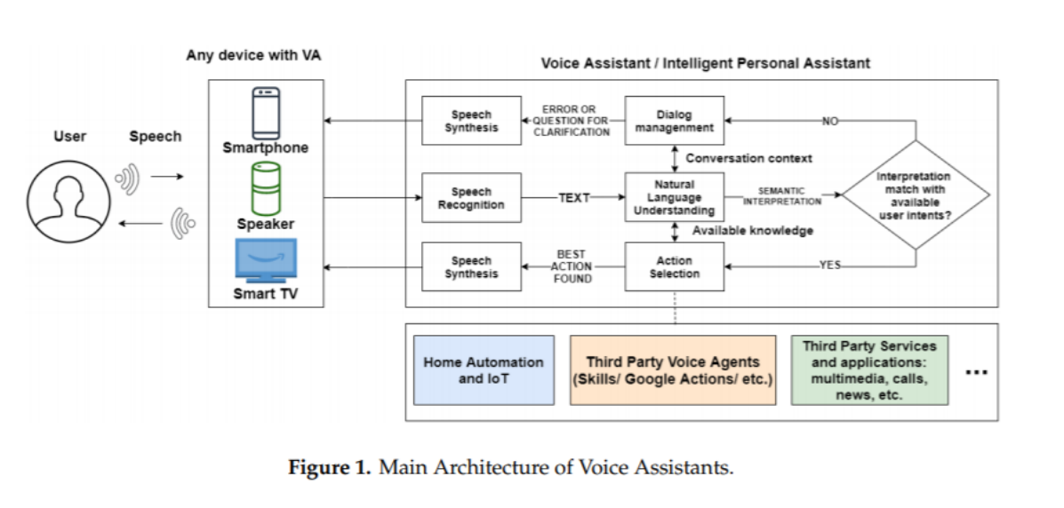

Slide 5
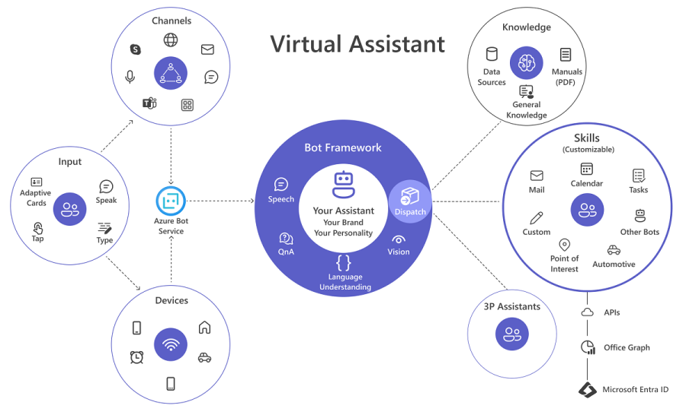

Slide 6
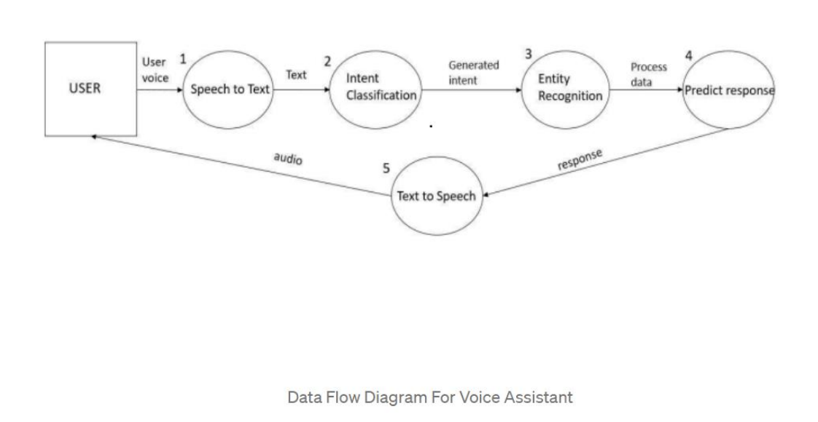

Slide 7
Voice Commands and Natural Language Processing
Voice Commands
Natural Language Processing
Virtual assistants use speech recognition to understand your voice commands.
Virtual assistants can understand and interpret natural language.
They can recognize different accents, dialects, and background noise.
They can understand complex sentences, synonyms, and different ways of expressing the same request.

Slide 8






Automating Routine Tasks with Virtual Assistants
Schedule Appointments
Say "Schedule a meeting for tomorrow at 10 AM" to add an event to your calendar.
Set Reminders
Say "Remind me to buy groceries later" to set a reminder for a specific task.
Send Emails
Say "Compose an email to John" to draft a new email and dictate the content.
Create To-Do Lists
Say "Add 'Finish project report' to my to-do list" to create a new task.

Slide 9

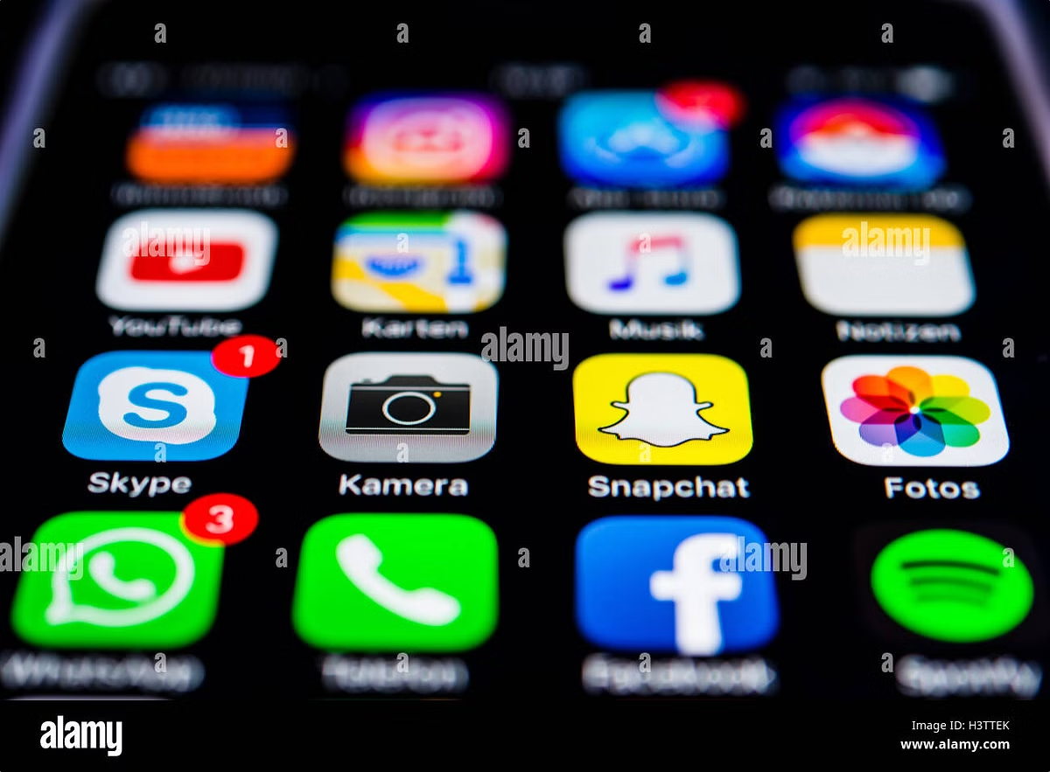
Integrating Virtual Assistants with other Applications
Calendar Apps
Google Calendar, Outlook Calendar
Email Clients
Gmail, Outlook
Messaging Apps
WhatsApp, Telegram
Music Streaming Services
Spotify, Apple Music
Smart Home Devices
Philips Hue, Nest

Slide 10


Personalizing the Virtual Assistant Experience
Customize Voice
Set Preferences
Change the virtual assistant's voice to a different gender, accent, or tone.
Adjust settings for notifications, privacy, and language.
Train Your Voice
Add Shortcuts
Improve the virtual assistant's accuracy by training it to recognize your voice.
Create custom shortcuts for frequently used commands.

Slide 11






Maintaining Privacy and Security with Virtual Assistants
Secure Data
Control Data Access
Virtual assistants should encrypt your data and protect it from unauthorized access.
You should be able to control which apps and services have access to your data.
Microphone Privacy
Regularly Review Settings
Ensure your virtual assistant only listens when you activate it.
Check your privacy settings regularly and update them as needed.

Slide 12


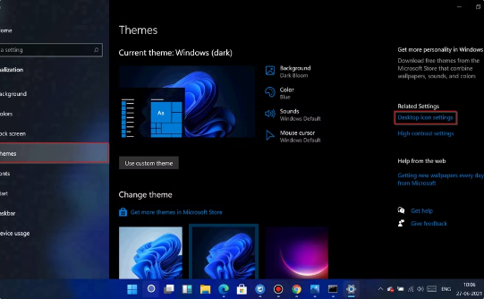
Troubleshooting and Optimizing Virtual Assistant Performance
Microphone Issues
Internet Connection
Software Updates
Make sure your microphone is properly connected and functioning.
Ensure you have a stable internet connection for reliable performance.
Keep your virtual assistant and operating system updated for optimal performance.

Slide 13


The Future of Virtual Assistants for PC Users
Virtual assistants are constantly evolving and improving. Expect advancements in natural language processing, integration with more applications, and enhanced security features. Virtual assistants will continue to play an increasingly important role in our lives, making our computers more powerful and user-friendly.

